Slide 1
Secure Data hiding in images using steganography
CAPSTONE PROJECT
Presented By
Student Name: Om Dilip Gaikwad
College Name & Department: Sinhgad College Of Science.

Slide 2
OUTLINE
Problem Statement
Technology used
Wow factor
End users
Result
Conclusion
Git-hub Link
Future scope

Slide 3
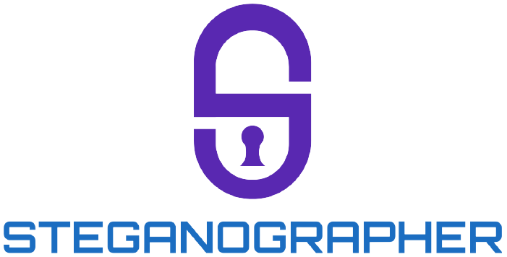
Problem Statement
This project creates a secure steganography system to hide data in images, using cryptography for security. It ensures high capacity, maintains image quality, and provides a user-friendly interface for safe data transmission.

Slide 4
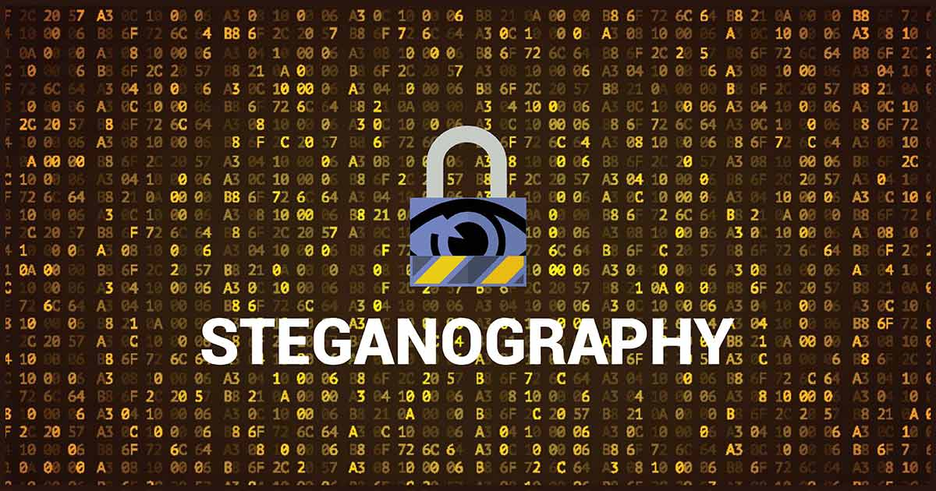
Technology used
Programming Languages: Python
Libraries :
a. OpenCv
b. Os
3. Operating System: Windows 64 Bits
4. Text Editor: IDLE Python 3

Slide 5
Wow factors
Uses encryption (e.g., AES, RSA) to protect hidden data
Robustness: Resists common image manipulations
Preserved Image Quality
User-Friendly Interface
High Data Capacity
This project stands out due to its unique combination of steganography and cryptography, ensuring covert data hiding and robust security. Key features are included in the following flowchart.

Slide 6
End users
Individuals: For secure personal communication and privacy protection.
Businesses/Corporations: To transmit sensitive data (e.g., financial, legal, or proprietary information) covertly.
Government and Defense Agencies: For secure and undetectable communication of classified information.
Researchers and Academics: For studying and implementing secure data transmission techniques.
These users benefit from the system's ability to hide data securely while maintaining image quality and ease of use.

Slide 7
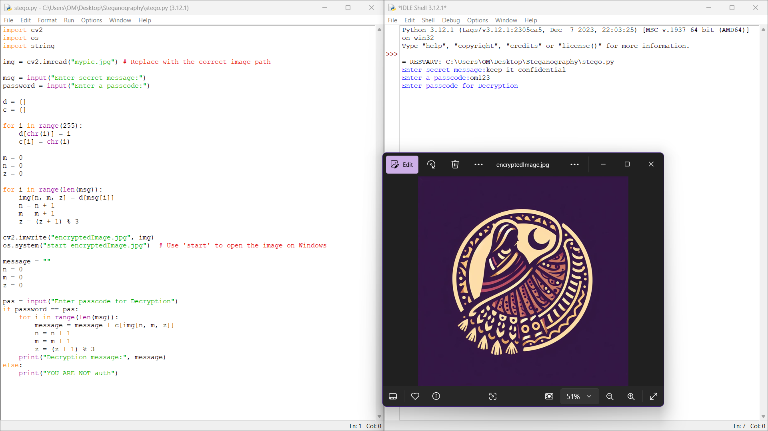
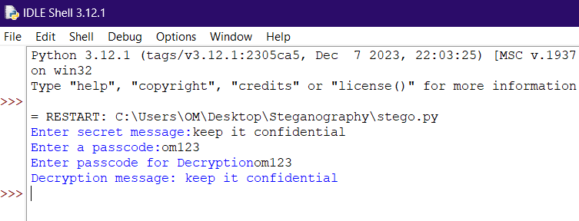
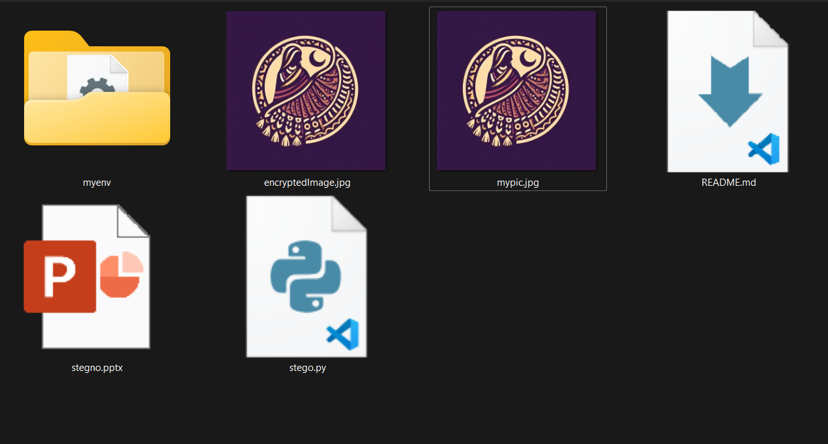
Results

Slide 8
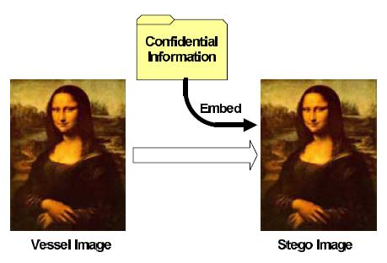
Conclusion
This project delivers a secure steganography system that hides data in digital images, combining cryptography for enhanced security. It ensures high data capacity, maintains image quality, and resists detection, providing a robust solution for covert communication. With its user-friendly interface, it caters to diverse users, including individuals, businesses, and government agencies, making it a reliable tool for secure and undetectable data transmission.

Slide 9
GitHub Link
GitHub Link - https://github.com/gaikwadomg/Steganography.git

Slide 10
Future scope
Future Scope
Real-Time Applications: Develop real-time data embedding and extraction capabilities for live communication systems.
Enhanced Security: Integrate advanced cryptographic methods (e.g., quantum cryptography) for future-proof security.
Multi-Media Support: Extend the system to support other media types, such as audio, video, and 3D images, for broader applications.

Slide 11
THANK YOU

